Slide 1
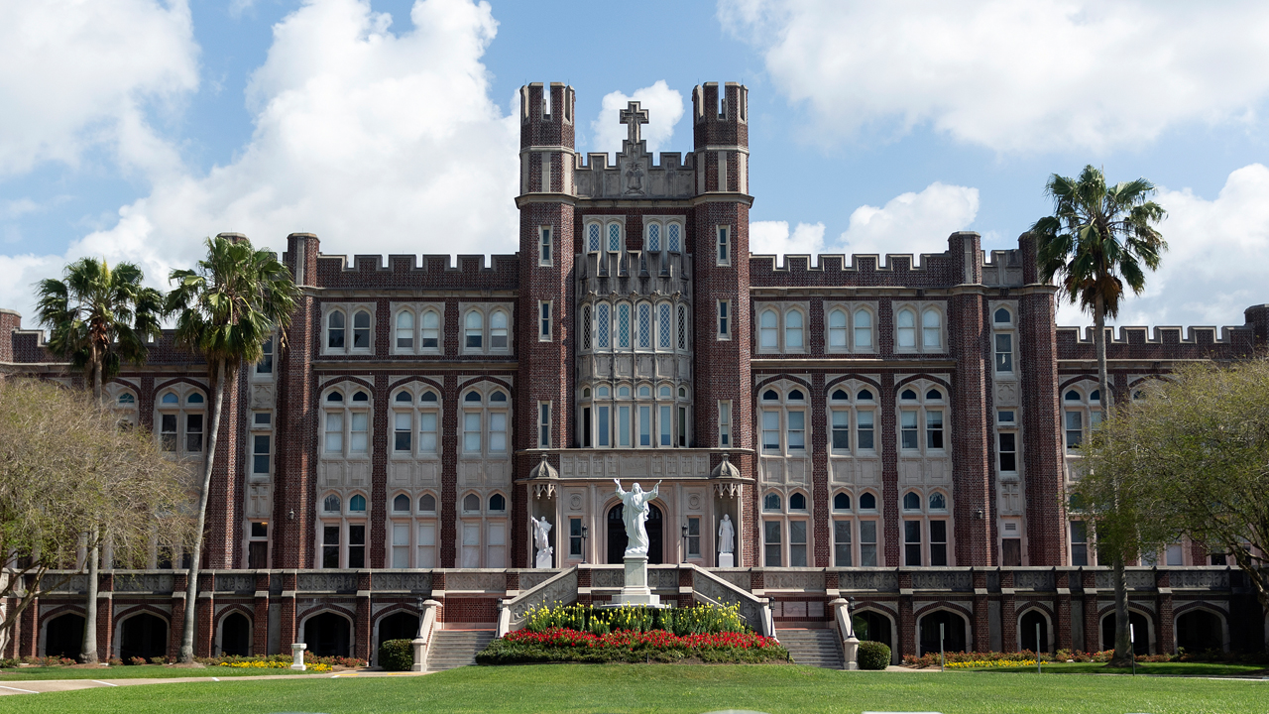
Loyola Institute for Ministry Extension Program
Information Session

Slide 2
Local Sponsoring Agency
[Name of your diocese or sponsoring agency here]
A Loyola Institute for Ministry education transforms the way you understand your faith and live your spirituality in the world.
The Loyola program fits into our overall education for ministry efforts.
[Add diocese logo]

Slide 3
Loyola: A Leader in Distance Education
affordable tuition
adult-centered learning communities
a Jesuit tradition of excellence and spirituality
programs offered onsite in your location
fully accredited

Slide 4
Options
Earn
Programs of Study
Graduate Credit Hours
Continuing Education Units (CEUs)
Certificate in Theology and Ministry (18 hours)
Master of / Certificate in Pastoral Studies (36 hours)
Master of / Certificate in Religious Education (36 hours)
Notes:
CEU students receive continuing education units as defined by the Southern Association of Colleges and Schools. One credit hour equals one CEU. CEUs are recorded on an official Loyola transcript and kept in the permanent records of the university.

Slide 5
Certificate in Theology and Ministry
18 credit hours or CEUs of Theological Core Courses
Introduction to Practical Theology (LIM 703)
The Jewish Roots of Christian Faith—Old Testament (LIM 711)
Christian Origins—New Testament (LIM 712)
Grace, Christ, and Spirit (LIM 714)
Church, Sacraments, and Liturgy (LIM 722)
Spirituality, Morality, and Ethics (LIM 704)
Taken in your area with a local learning group led by a Loyola-certified facilitator.

Slide 6
Master’s Degree or Certificate in Pastoral Studies or Religious Education
36 credit hours or CEUs
6 theological core courses taken in the extension format with your local learning group
2 elective courses
3 focus area courses
1 capstone course
Elective, focus area and capstone courses can be taken online concurrently with extension courses or after completing the Certificate in Theology and Ministry.

Slide 7
Focus Areas
Religious Education
Youth and Young Adult Ministry
Religion and Ecology
Pastoral Care
Digital Culture and Ministry
Christian Spirituality for Ministry
Pastoral Life and Administration
Small Christian Community Formation
Marketplace Ministry
Individualized Track

Slide 8
Admission Requirements
Application Elements
Statement of Educational Purpose
a completed application
a résumé of work, volunteer service, and/or ministry experience
two recommendation forms (no relatives)
a sponsoring agency letter to Loyola liaison
a statement of educational purpose
a bachelor's degree from an accredited college/university, with a minimum 2.5 G.P.A and submission of official transcripts from all colleges or universities previously attended (for students applying for graduate credit; not necessary for applicants seeking CEU credit)
A typed, three-page, double-spaced essay that reflects your understanding of how LIM can help you improve your ministry. It must
state your reasons for seeking a master’s degree or continuing education certificate.
elaborate on your ability and willingness to engage fully in the group learning process used in the program.
include additional information about yourself that would assist LIM in evaluating your academic and ministerial background and your ability to engage in graduate-level ministry education.

Slide 9
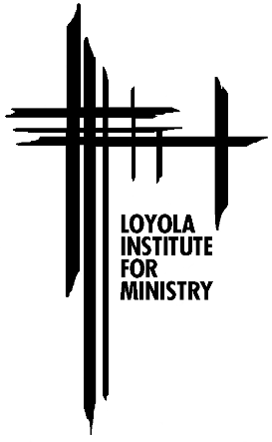
For More Information
Loyola Institute for Ministry website: cnh.loyno.edu/lim
Admissions Application:
grad.loyno.edu/apply/
Questions regarding the application process: Debi Mahr, Assistant to the Director
dmahr@loyno.edu 504-865-3079
Questions regarding local group: [enter liaison name and professional title]
[enter liaison email] [enter liaison phone]
Questions regarding the program: Dr. Tracey Lamont, Director of the Loyola Institute for Ministry
tlamont@loyno.edu 504-865-2797

